Slide 1


FCS 07 & 10
Dave Peters
Director of Student Support Services
Behavior Management ​and ​De-escalation
Cultivating a Positive &
Safe Learning Environment ​
Notes:
Welcome... Introduce us, questions for group:
How many are elementary, middle, high? Special ed, supervision, other (call out please)
Turn to your group and share what you are most excited about for the start of this year

Slide 2


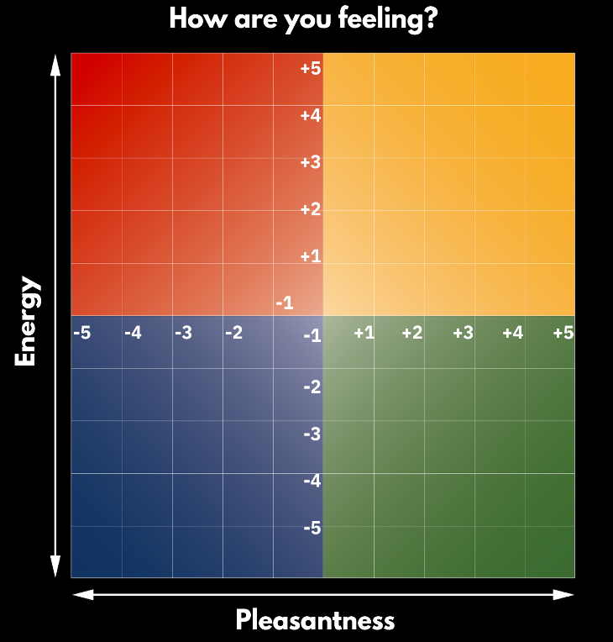




How are you feeling today?

Slide 3

Identify specific roles in support of classroom management and student discipline.
Define the philosophy of an inclusive and equitable learning environment.
Identify equitable and inclusive strategies that can be used to support a positive and safe learning environment including de-escalation strategies.
Identify positive and proactive supports that can be used within the classroom or school environment.
Define proactive approaches to student behavior management and de-escalation strategies.
OUTCOMES
Notes:
Read through the objectives
Our superintendent speaks of our four pillars: climate, culture, systems and instruction. The work we will do today addresses climate & culture as a foundation for instruction.
The work we will do today can be summed up as the ‘knowledge, mindsets, beliefs and practices of a school professional’—disciplines of thinking and behaving with students.

Slide 4

Policies in Everett Public Schools
What is Discipline?
“Discipline” means any action taken by the district in response to behavioral violations including exclusionary as well as positive and supportive forms of discipline
Notes:
At your table discuss your experience with school discipline as a student.
Now discuss your professional experience with discipline.
**Important to note that both of these experiences are likely different than your experience as a child within your home or with your own children. These experiences are so tied to strong relationships, history in relationships, safety in relationships, etc. that they typically have different characteristics.
Discipline means both our responses to behavior violations and the positive and supportive actions we take before, during, and after behavior violations. And we know that putting our time, effort and energy to what we do before there are any problem behaviors is not only how to best avoid problem behaviors but it is also what’s best for kids and for us to make school a joyful place to come.

Slide 5




What it is NOT
Notes:
Rather than highlight our learners who are struggling…

Slide 6

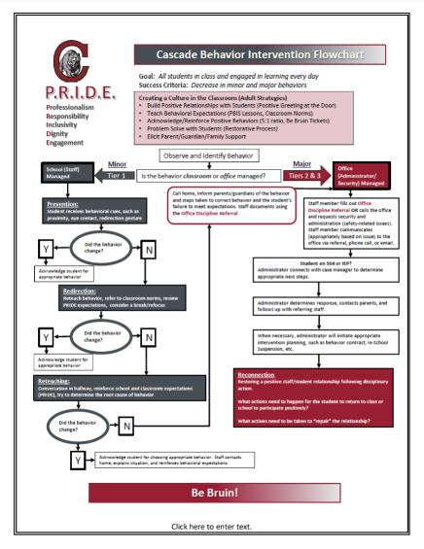
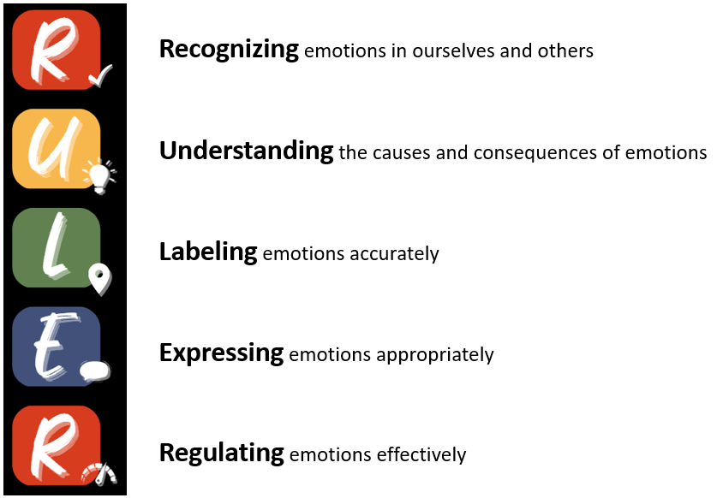


Notes:
In our schools you’ll find what this looks like is a coordinated set of school-wide practices that support positive and safe environments. School-wide systems that define and support expectations, routines, and rules; an organized flowchart for responding to problem behaviors that defines how adults manage behaviors as the occur and access support from administrators when needed, and SEL curriculum that develops the skills and competencies kids need to participate in school, relationships, and communities.
Pass to Terry to define this further.

Slide 7
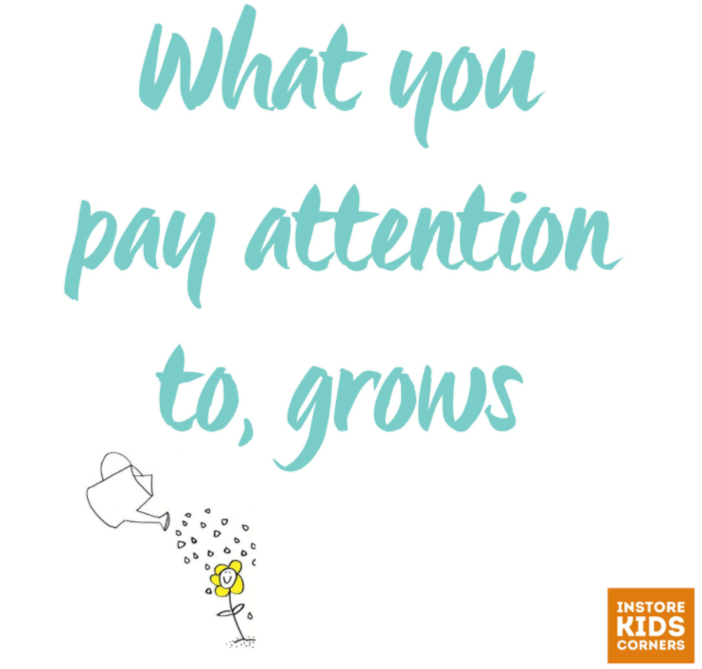
Notes:
So what you’ll find at EPS and in this training today is a shift from learning how to manage behavior after a problem occurs to how we focus on the supportive and safe environment we all want to be a part of.

Slide 8

Importance of Clear Expectations & Communication
Notes:
Read through the objectives
Our superintendent speaks of our four pillars: climate, culture, systems and instruction. The work we will do today addresses climate & culture as a foundation for instruction.
The work we will do today can be summed up as the ‘knowledge, mindsets, beliefs and practices of a school professional’—disciplines of thinking and behaving with students.

Slide 9


Importance of Clear Expectations & Communication
Notes:
Read through the objectives
Our superintendent speaks of our four pillars: climate, culture, systems and instruction. The work we will do today addresses climate & culture as a foundation for instruction.
The work we will do today can be summed up as the ‘knowledge, mindsets, beliefs and practices of a school professional’—disciplines of thinking and behaving with students.

Slide 10

Using Clarity in Our Words
ROUND ONE
ROUND TWO
Don’t sit down.
Don’t put your hands by your sides.
Don’t close your mouth.
Don’t look at me.
Don’t stand still.
Don’t stand up.
Stand up.
Raise your hands.
Open your mouth.
Look at another person.
March in place.
Sit down.
10
Notes:
Say: The last part is the teaching interaction, a standardized method of addressing problem behavior. This is when you have to teach to redirect the problem behavior. A teaching interaction gives students with problem behaviors an opportunity to learn the appropriate and desired behavior. It’s important to note that learning cannot happen when people are in flight or fight mode. We have to be able to preserve relationships to get to the new or relearning the appropriate behavior.

Slide 11

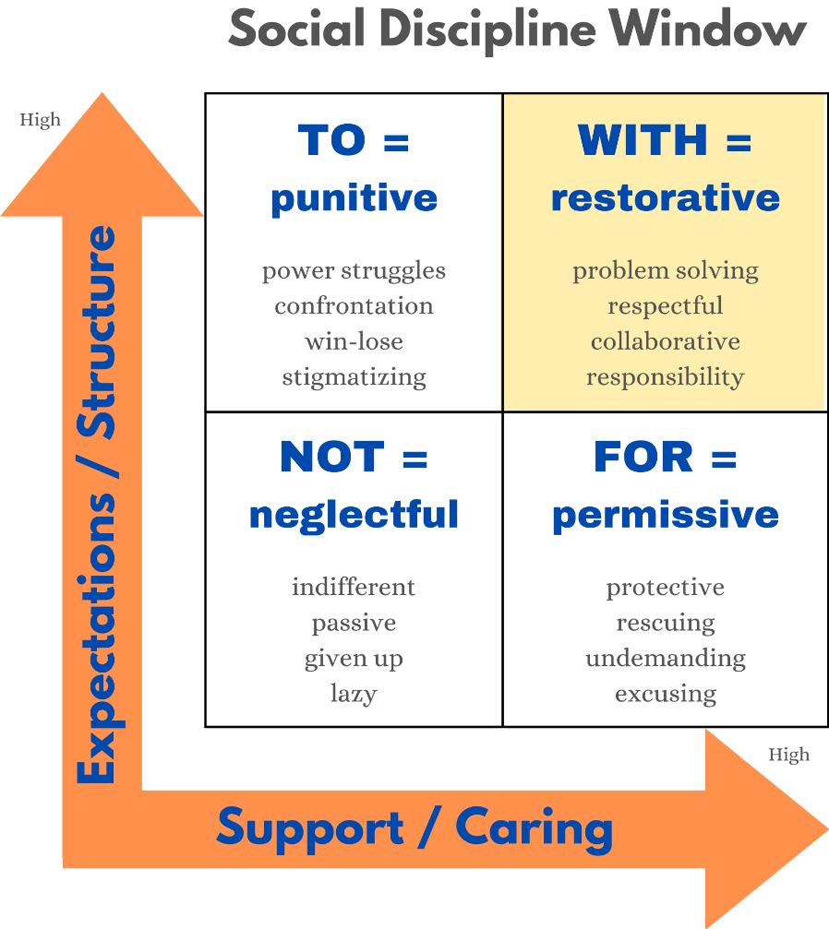
RESTORATIVE PRACTICES

Slide 12

Discipline or Non-Example?
Reflect while watching
Why did this student act out?
Did you observe any approaches with the student that appeared to be helpful?
What could have perhaps been done differently to minimize an escalated situation?
https://youtu.be/n6fS73AFnnk?si=j1gm9oteTPNeALnC
Notes:
8:23 Say: Let’s watch the following video on de-escalation.
Ask: Were any of the approaches to student behavior management and de-escalation we covered already today present in this video?
What could have been done differently to prevent the escalated situation?
Note: Video is 8 minutes and 23 seconds long.
Video url: https://www.youtube.com/watch?v=X9_WwuGF4dM&feature=emb_title

Slide 13


Emotion Scientists vs Emotion Judges
Emotion judges are critical, reactionary, inflexible, and make assumptions.
Emotion scientists are empathic, inquisitive, active listeners, reflective, and focus on the facts.
How does this play into:
Recognizing? (The emotion judge makes quicks assumptions and may misdiagnose emotion by observing behavior)
Understanding? (The emotion scientist asks good questions)
Labeling? (The emotion judge just labels what others are feeling or even attributes emotions to people’s personalities)
Expressing? (The emotion judge makes assumptions
about why people are expressing emotions the way
they do, e.g., “She’s not sharing because she’s
jealous”)
Regulating? (The emotion scientist explores new
regulation strategies through trial and error)

Slide 14
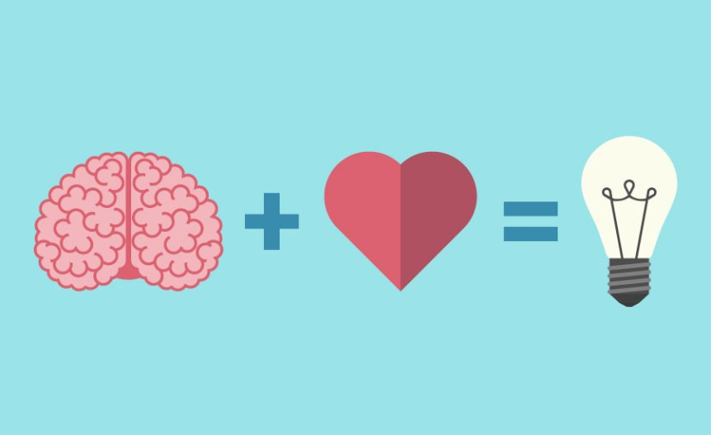
WHAT do emotions IMPACT?
Memory Formation
Social Interactions
Creativity
Performance
Motivation
Attention
Engagement
Relationships
Physical & Mental Health
Decision Making
Critical Thinking
Interest
Focus
Notes:
Here's why emotions matter for learning:
Attention and Focus: Emotions can impact your level of attention and focus. When you are emotionally engaged, your brain tends to prioritize the information and experiences associated with those emotions. This can lead to better concentration and improved comprehension of the material.
Memory Formation: Emotions can enhance memory formation. Information that is emotionally charged or connected to personal experiences is more likely to be stored in long-term memory. Emotions create a "memory marker" that helps your brain remember and retrieve information later.
Motivation and Interest: Positive emotions like curiosity, excitement, and interest can motivate you to learn. When you find a subject emotionally appealing, you're more likely to invest time and effort in understanding and retaining the material.
Emotional Context: Emotions provide a context for learning. They help you connect new information to your existing knowledge and experiences, making it easier to understand and remember. For example, if you associate a certain word with a strong emotion, you're more likely to recall that word when needed.
Neurological Connections: Emotions can stimulate the release of neurotransmitters such as dopamine, which can enhance the brain's ability to form new connections between neurons. These connections facilitate the transfer of information, making it easier for you to learn and remember new words.
Reduced Stress: Positive emotions can reduce stress and anxiety, which are known to impede the learning process. When you're in a positive emotional state, your brain is more receptive to new information and is better equipped to process and remember it.
Application and Real-World Use: Emotions can help you understand the practical applications of the words you're learning. Connecting words to real-life scenarios and emotions can make them more meaningful and easier to remember in context.
Personalization: Emotions personalize the learning experience. When you relate emotionally to the material, it becomes a part of your own story and identity, increasing the likelihood of long-term retention.
Creativity and Critical Thinking: Emotions can enhance your creative thinking and critical analysis skills. An emotionally engaged mind is more likely to explore different perspectives, ask questions, and make connections between concepts.
Social Learning: Emotions play a crucial role in social interactions. Learning often involves communication and sharing, and emotions can help you connect with others, leading to discussions, debates, and a deeper understanding of the words you're learning.
In essence, emotions serve as a bridge between cognitive processes and personal experiences, helping to make learning more effective, enjoyable, and memorable. Even when dealing with a relatively small number of words, the emotional context can significantly impact your ability to learn and retain them.

Slide 15

EMOTIONAL INTELLIGENCE: Why?
Educators and leaders with higher emotional intelligence:
Demonstrate more empathy and greater sensitivity to others’ needs
Develop higher performing teams and build a warmer and more supportive emotional school climate
Receive higher performance
ratings and experience less
stress and burnout

Slide 16

EMOTIONAL INTELLIGENCE: Why?
Students who are skilled in emotional intelligence:
Experience fewer problems with attention, hyperactivity, substance abuse, anxiety, and depression
Engage less in aggressive or socially deviant behavior
Achieve more academically, and experience better relationships, more satisfaction with school, and better wellbeing overall
Participate frequently in classroom
activities, cope in healthier ways
with stress, and behave in more
empathic and prosocial ways

Slide 17
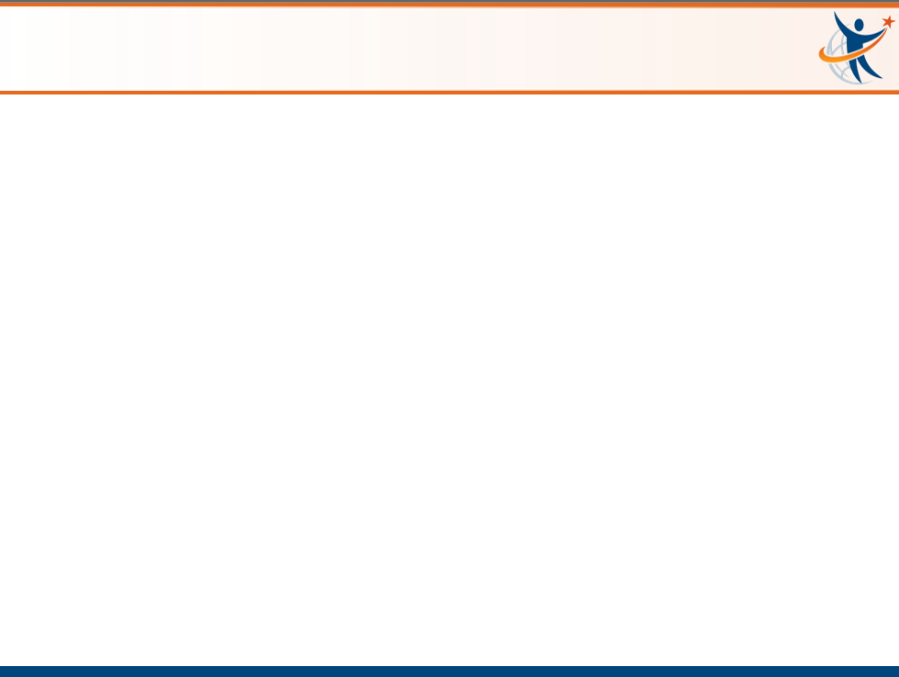

Emotions Matter Mindset
SEL

Slide 18

The RULER Skills
Recognizing emotions in ourselves and others
Understanding the causes and consequences of emotions
Labeling emotions accurately
Expressing emotions appropriately
Regulating emotions effectively

Slide 19




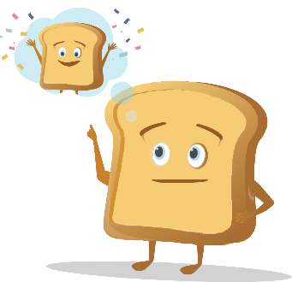
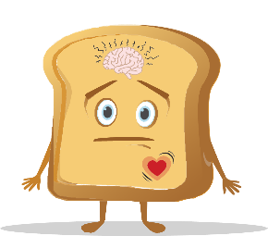
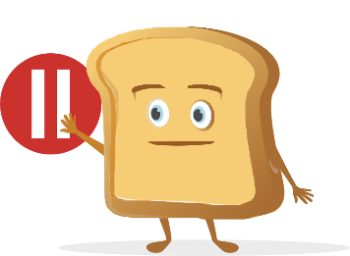
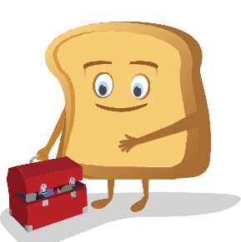
META-MOMENT
The Meta-Moment consists of four steps:
  Sense that something has happened or changed in your environment
  Pause to de-escalate and avoid responding in an unhelpful manner
  See your best self, or visualize a positive image of yourself
  Strategize and act in a more helpful manner
Notes:
The Meta-Moment teaches both children and adults to prolong the space between that trigger that we all have and our reaction or our healthy response. And it's a process during an interaction that helps people first recognize a shift that just occurred. You are activated with a strong emotion, caught off guard, or have an impulse to say or do something you might regret. You feel a shift in your thinking or body or both.
The second piece of the Meta-Moment says let's pause. Let's not react; let's take that breath; let's build that space.
The third part of the Meta-Moment is called your best self. Think of adjectives or an image that helps your best self appear in vivid detail, or look at an object that reminds you. You might also think about your reputation: How do you want to be seen, talked about, and experienced? What would you do if someone you respect were watching you? And what they have found in their research is that when you can teach children and adults to think about their best self - meaning I am a teacher who is caring and compassionate; I am a parent who is loving and kind - that activation of your best self helps you to choose more effective strategies…
…to then move to step 4, which is the regulation of emotion or strategizing. That instead of using negative self-talk, you use positive self-talk. Instead of blaming you'll start reframing. Instead of yelling and screaming, you'll do problem solving.
The goal is that successful interaction in that process. So it's this process to really help people manage emotions more effectively and build relationships as opposed to destroy them.

Slide 20
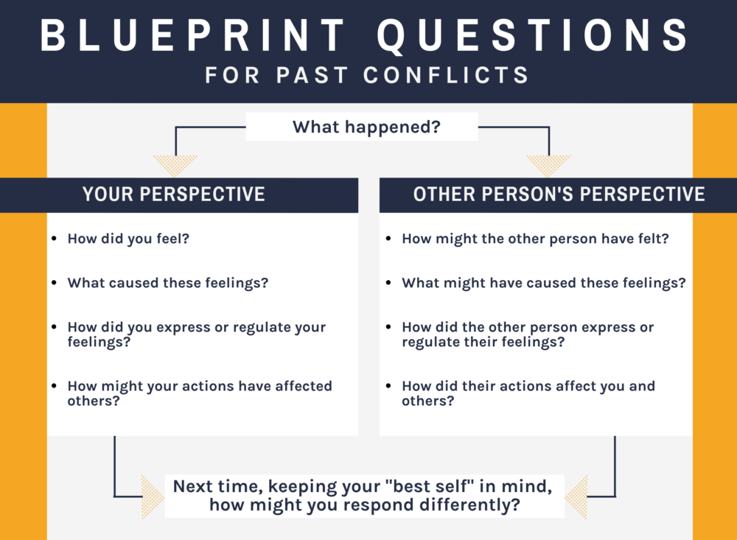
THE BLUEPRINT

Slide 21
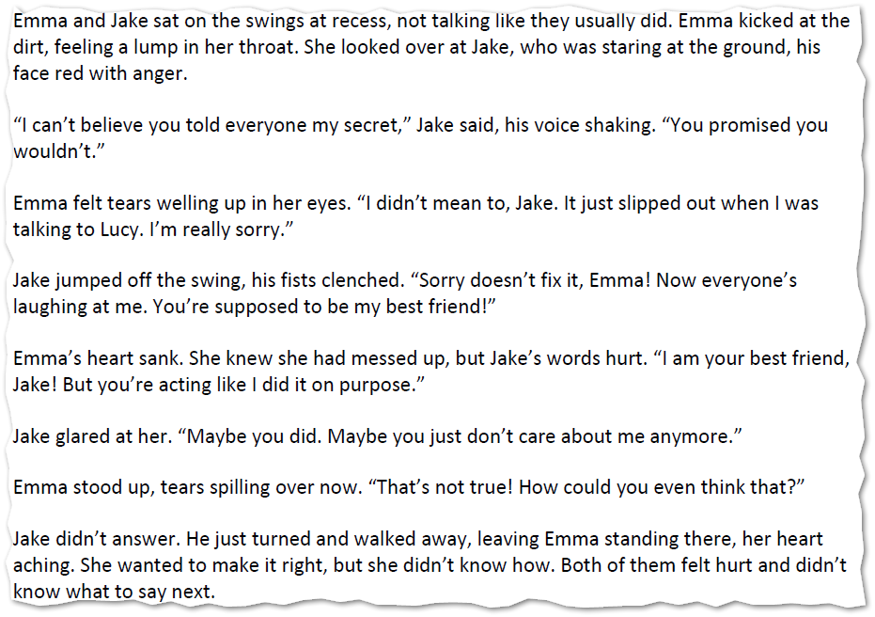
THE BLUEPRINT

Slide 22

THE CHARTER
There is a clear gap between how school community members feel and how they want to feel. This presents us with an opportunity–a call to action to develop plans for enhancing emotional climates.
This is where the Charter comes in. The Charter allows everyone in a school community the chance to articulate how they want to feel at school, then work together to agree upon behaviors that support those feelings. As a group, the school community members decide on what needs to happen or change for those feelings to be consistently present.
All Charters are structured around two primary
questions:
  How do we want to feel?
  How will we help each other to
  experience these feelings?

Slide 23
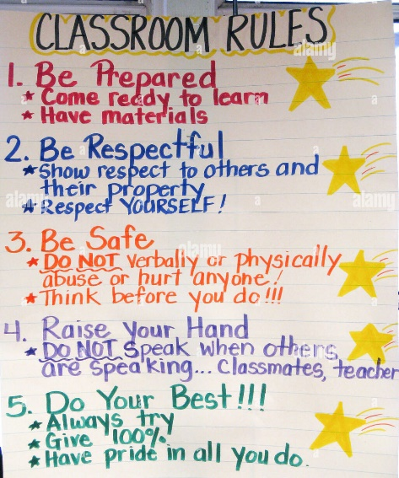
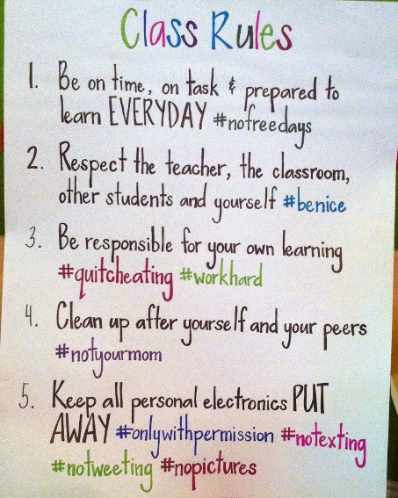
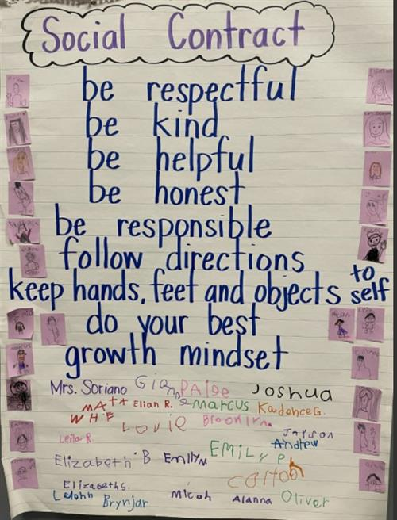
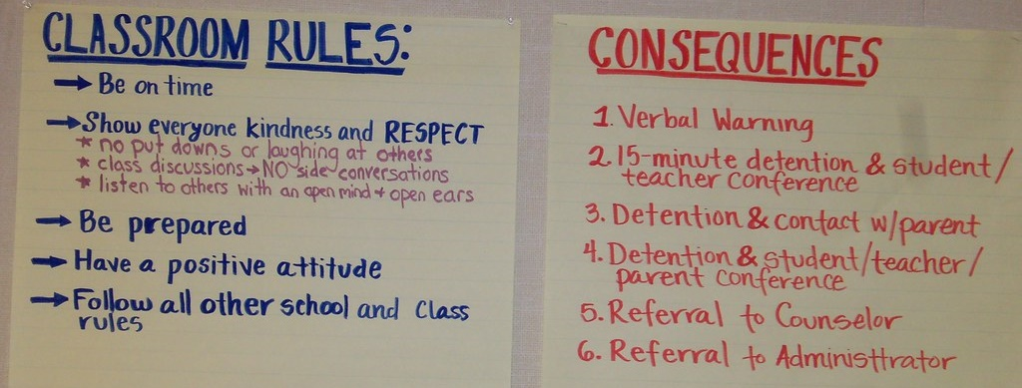
CHARTER vs rules

Slide 24
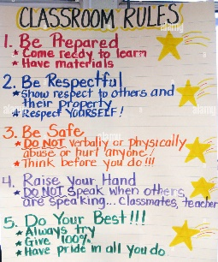


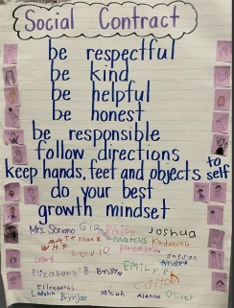

THE VALUE OF A CHARTER
The Charter creates the WHY for the classroom rules or social contract. How we want to feel will lead into strategies that will foster and maintain them. The “rules” naturally follow – but rather than for basic compliance, they will have a deeper level of meaning and purpose.

Slide 25
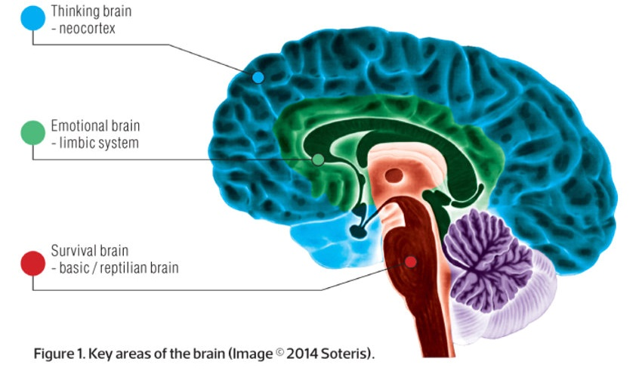
A Look Under the Hood
Notes:
Cortisol is a steroid hormone that is produced by your 2 adrenal glands, which sit on top of each kidney. When you are stressed, increased cortisol is released into your bloodstream. Having the right cortisol balance is essential for your health, and producing too much or too little cortisol can cause health problems.
Cortisol has many important functions, acting on many different parts of your body. It can help:
your body respond to stress or danger
increase your body’s metabolism of glucose
control your blood pressure
reduce inflammation
Cortisol is also needed for the ‘fight or flight’ response, which is your healthy, natural response to perceived threats. The amount of cortisol produced is controlled by your body to ensure the balance is correct.
HPA: hypothalamic-pituitary-adrenal
Oxytocin exerts stress-buffering effects to inhibit the stress-induced HPA activity and decrease cortisol levels. When cortisol stress responses and the protective stress-buffering effects of oxytocin reach a balance, homeostasis is preserved.
The mutual regulation between these two systems would thus be considered as a sign of resilience to stress
How are oxytocin levels controlled?
Oxytocin production and secretion is controlled via a positive feedback loop. This means the hormone causes an action that stimulates more of its own release.
A promising way to boost oxytocin naturally is with exercise.
Music also seems to have the ability to increase oxytocin levels, especially when people sing in a group, which adds the element of bonding.
Just the simple act of touch seems boost oxytocin release. Giving someone a massage, cuddling, making love, or giving someone a hug leads to higher levels of this hormone and a greater sense of well-being.
What are the Differences Between Cortisol and Adrenaline?
Cortisol vs adrenaline - they both play important roles in your body. The fundamental differences between cortisol and adrenaline are the stimuli that promote the release of these hormones, the effect on the body, and the role they play in your overall health and well-being.
When working properly, cortisol starts the day off higher, and then levels come down as the sun goes down, to prepare for sleep.
It is also released during stressful and anxiety inducing events and periods in your life to help you deal with what is happening in the moment.
Adrenaline, in contrast, is released during dangerous or exciting moments and creates the right environment for you to either fight or flee from danger. Think of adrenaline as your emergency hormone. It helps you to get out of sticky situations but isn’t necessary for daily health and functions.
Because adrenaline and cortisol both respond to forms of stress and can have overlapping effects, it is possible to confuse the experience of high cortisol with adrenaline. The key point to remember is that adrenaline is released as a last resort to deal with a dangerous situation. If you are not in danger or excited, then you’re likely experiencing high cortisol.

Slide 26
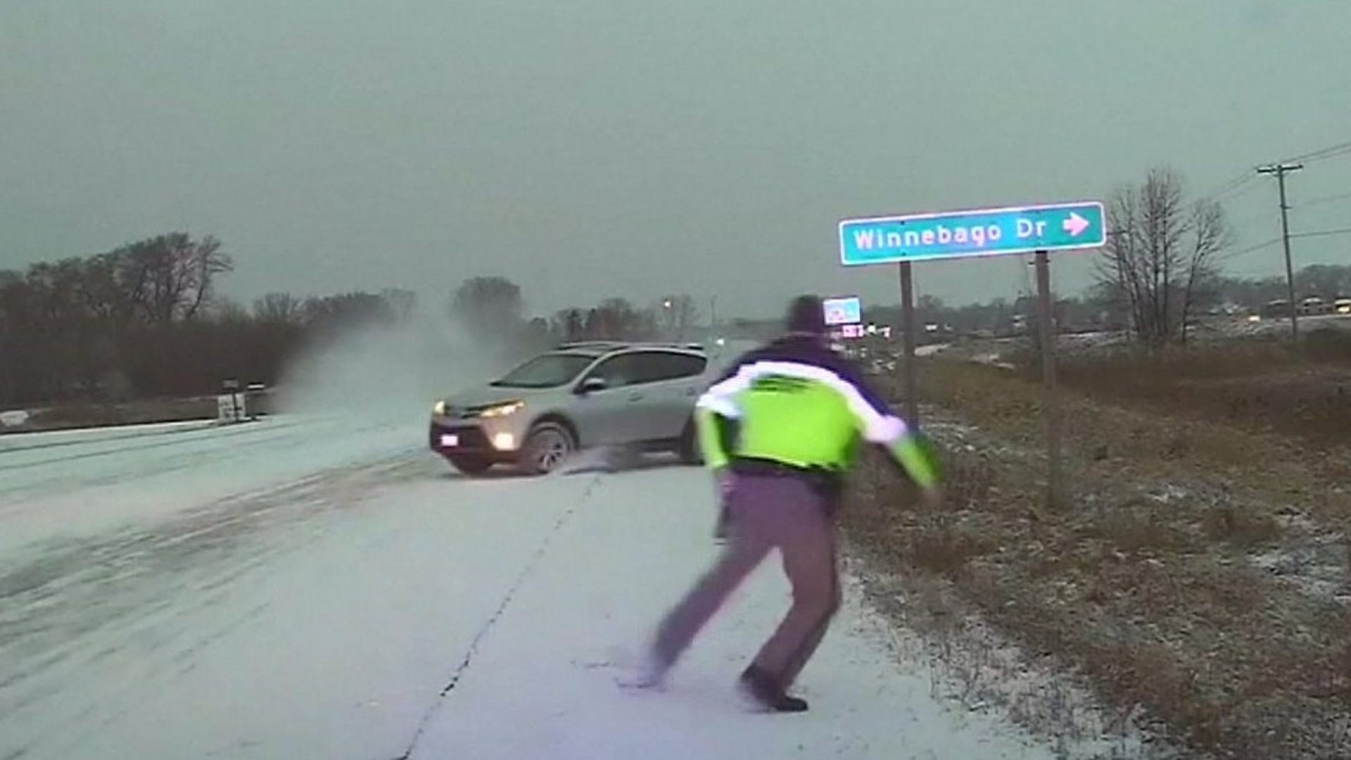
The Order of Brain Operations
The emotion brain responds to an event more quickly than the thinking brain.
-Daniel Goleman
Notes:
Cortisol is a steroid hormone that is produced by your 2 adrenal glands, which sit on top of each kidney. When you are stressed, increased cortisol is released into your bloodstream. Having the right cortisol balance is essential for your health, and producing too much or too little cortisol can cause health problems.
Cortisol has many important functions, acting on many different parts of your body. It can help:
your body respond to stress or danger
increase your body’s metabolism of glucose
control your blood pressure
reduce inflammation
Cortisol is also needed for the ‘fight or flight’ response, which is your healthy, natural response to perceived threats. The amount of cortisol produced is controlled by your body to ensure the balance is correct.
HPA: hypothalamic-pituitary-adrenal
Oxytocin exerts stress-buffering effects to inhibit the stress-induced HPA activity and decrease cortisol levels. When cortisol stress responses and the protective stress-buffering effects of oxytocin reach a balance, homeostasis is preserved.
The mutual regulation between these two systems would thus be considered as a sign of resilience to stress
How are oxytocin levels controlled?
Oxytocin production and secretion is controlled via a positive feedback loop. This means the hormone causes an action that stimulates more of its own release.
A promising way to boost oxytocin naturally is with exercise.
Music also seems to have the ability to increase oxytocin levels, especially when people sing in a group, which adds the element of bonding.
Just the simple act of touch seems boost oxytocin release. Giving someone a massage, cuddling, making love, or giving someone a hug leads to higher levels of this hormone and a greater sense of well-being.

Slide 27
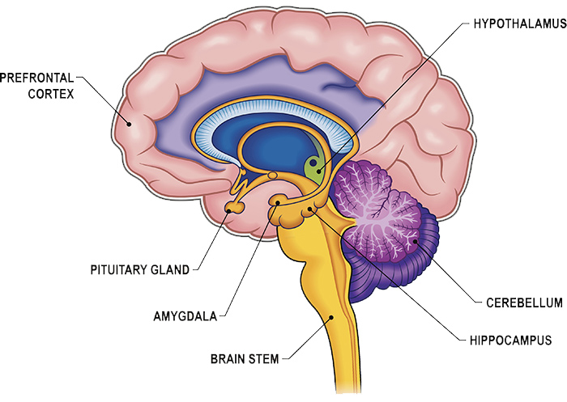
A Look Under the Hood
Attention
Concentration
Focus
Emotion Regulation
Reactivity
Learning
Episodic Memory
Understanding the Brain’s Threat & Stress Response
Notes:
Cortisol is a steroid hormone that is produced by your 2 adrenal glands, which sit on top of each kidney. When you are stressed, increased cortisol is released into your bloodstream. Having the right cortisol balance is essential for your health, and producing too much or too little cortisol can cause health problems.
Cortisol has many important functions, acting on many different parts of your body. It can help:
your body respond to stress or danger
increase your body’s metabolism of glucose
control your blood pressure
reduce inflammation
Cortisol is also needed for the ‘fight or flight’ response, which is your healthy, natural response to perceived threats. The amount of cortisol produced is controlled by your body to ensure the balance is correct.
HPA: hypothalamic-pituitary-adrenal
Oxytocin exerts stress-buffering effects to inhibit the stress-induced HPA activity and decrease cortisol levels. When cortisol stress responses and the protective stress-buffering effects of oxytocin reach a balance, homeostasis is preserved.
The mutual regulation between these two systems would thus be considered as a sign of resilience to stress
How are oxytocin levels controlled?
Oxytocin production and secretion is controlled via a positive feedback loop. This means the hormone causes an action that stimulates more of its own release.
A promising way to boost oxytocin naturally is with exercise.
Music also seems to have the ability to increase oxytocin levels, especially when people sing in a group, which adds the element of bonding.
Just the simple act of touch seems boost oxytocin release. Giving someone a massage, cuddling, making love, or giving someone a hug leads to higher levels of this hormone and a greater sense of well-being.
What are the Differences Between Cortisol and Adrenaline?
Cortisol vs adrenaline - they both play important roles in your body. The fundamental differences between cortisol and adrenaline are the stimuli that promote the release of these hormones, the effect on the body, and the role they play in your overall health and well-being.
When working properly, cortisol starts the day off higher, and then levels come down as the sun goes down, to prepare for sleep.
It is also released during stressful and anxiety inducing events and periods in your life to help you deal with what is happening in the moment.
Adrenaline, in contrast, is released during dangerous or exciting moments and creates the right environment for you to either fight or flee from danger. Think of adrenaline as your emergency hormone. It helps you to get out of sticky situations but isn’t necessary for daily health and functions.
Because adrenaline and cortisol both respond to forms of stress and can have overlapping effects, it is possible to confuse the experience of high cortisol with adrenaline. The key point to remember is that adrenaline is released as a last resort to deal with a dangerous situation. If you are not in danger or excited, then you’re likely experiencing high cortisol.

Slide 28
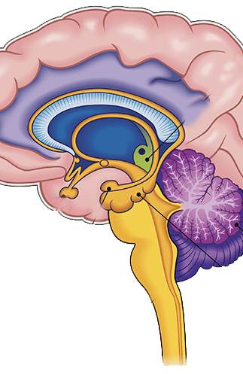
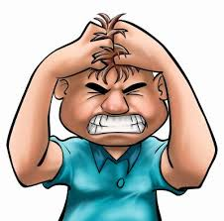
When Emotion Mind Takes Over
Prefrontal Cortex Shuts Down
No problem solving
No new learning
Rationale Mind is Blocked
  Distorted thoughts occur
Impulse Control Decreases
  Can’t engage in non-mood dependent behaviors
Limbic System Activates
Emotion Intensity Increases
Physiological Cues Activate
  Can’t regulate physiology
Can only focus on Emotion Cues
Notes:
Cortisol is a steroid hormone that is produced by your 2 adrenal glands, which sit on top of each kidney. When you are stressed, increased cortisol is released into your bloodstream. Having the right cortisol balance is essential for your health, and producing too much or too little cortisol can cause health problems.
Cortisol has many important functions, acting on many different parts of your body. It can help:
your body respond to stress or danger
increase your body’s metabolism of glucose
control your blood pressure
reduce inflammation
Cortisol is also needed for the ‘fight or flight’ response, which is your healthy, natural response to perceived threats. The amount of cortisol produced is controlled by your body to ensure the balance is correct.
HPA: hypothalamic-pituitary-adrenal
Oxytocin exerts stress-buffering effects to inhibit the stress-induced HPA activity and decrease cortisol levels. When cortisol stress responses and the protective stress-buffering effects of oxytocin reach a balance, homeostasis is preserved.
The mutual regulation between these two systems would thus be considered as a sign of resilience to stress
How are oxytocin levels controlled?
Oxytocin production and secretion is controlled via a positive feedback loop. This means the hormone causes an action that stimulates more of its own release.
A promising way to boost oxytocin naturally is with exercise.
Music also seems to have the ability to increase oxytocin levels, especially when people sing in a group, which adds the element of bonding.
Just the simple act of touch seems boost oxytocin release. Giving someone a massage, cuddling, making love, or giving someone a hug leads to higher levels of this hormone and a greater sense of well-being.

Slide 29

The Power of Relationships in Schools
https://youtu.be/kzvm1m8zq5g?si=QyMrDStN9lRl7ClF

Slide 30
Relationships Matter
Some statements from the video…
Strong relationships are central to the learning process.
When students have experiences of closeness, consistency, and trust, oxytocin is released.
When we think about a relationship, we’re not just talking about being nice to a child, we’re talking about a child having an experience of attunement and trust strong enough to release the hormone oxytocin.
The purpose of my morning greeting is to connect with them and to just make sure I’m seeing them as humans.
Emotions and learning are completely connected.
Notes:
But when we say relationships, that gets a little more complex and the stakes increase.

Slide 31
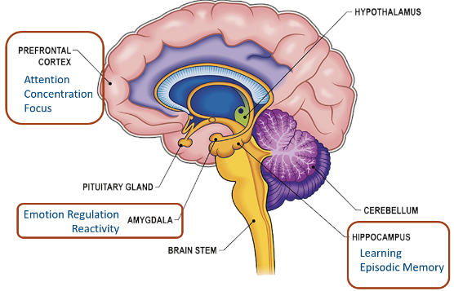
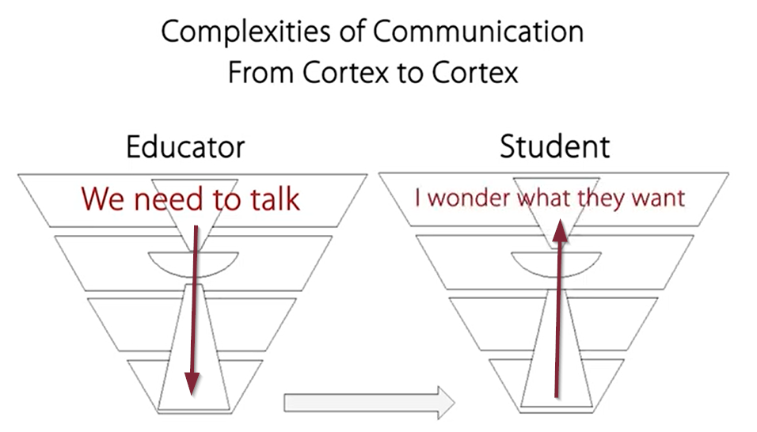
Understand the Brain & Begin with Relationships!

Slide 32
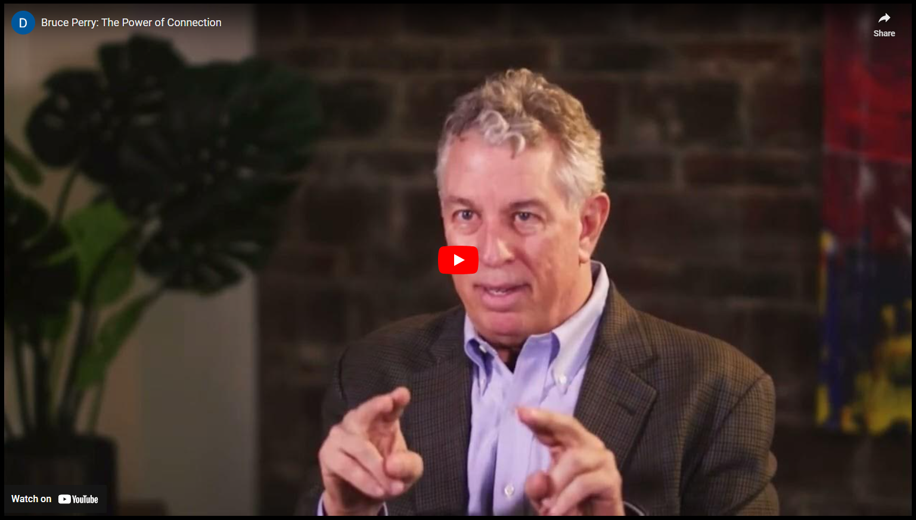
Stress, Trauma & the Brain | Bruce Perry
https://youtu.be/x3jSMWTLnpg?si=pVK_ygnyZKgl2U73
32
Notes:
3:30

Slide 33
The Power of Connection
-Bruce Perry
Application questions…
Dr. Perry lists simple examples of relational “power” that educators can access to make significant regulatory impacts with their students. Describe
several that you believe could most benefit your school.
With your understanding of the brain systems, why do you think these actions and gestures are helpful to students and their learning?

Slide 34
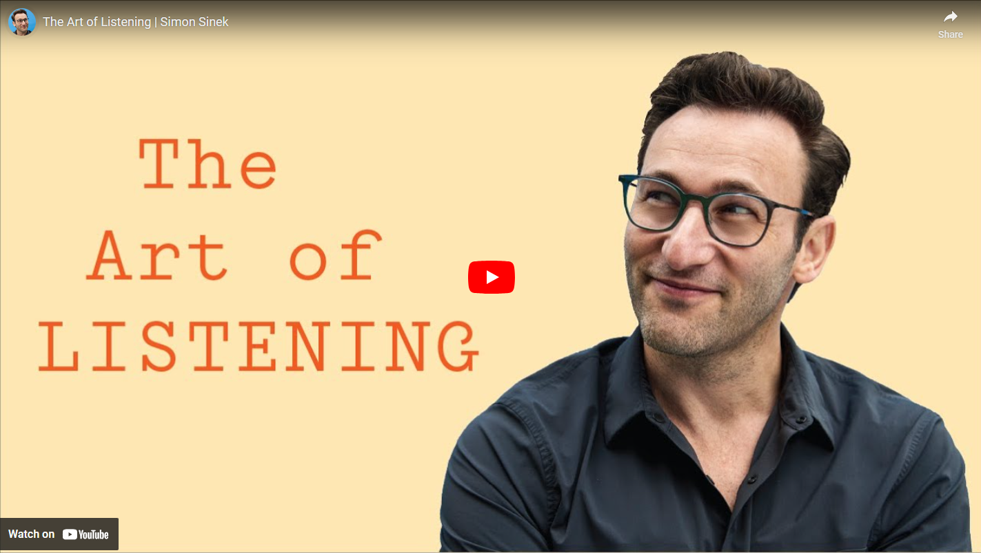
Active Listening
https://youtu.be/qpnNsSyDw-g

Slide 35
Active Listening
Application questions…
How might this understanding of active listening connect with RULER and developing “Emotion Scientists”?
Describe the relationship between active listening and empathy.

Slide 36

The Power of Validation
It’s acknowledging to another person that the pathway to their feelings is understandable and sensible. You’re creating space for that person to experience these emotions and process things without fear of judgement or rejection.

Slide 37
Invalidating Environment
tells the individual that what he/she/they is thinking, feeling, or doing is wrong or inaccurate
Examples:
“At least…” or “It could be worse”
“Don’t worry so much”
“Well, I would feel like/think of it like this”
“You shouldn’t feel that way ”
“Just move on”
“You're taking X too seriously”
“You could have avoided this if you did X”
“Why would you be scared, that’s stupid”
“Well, if you don’t talk to her, it’s your own fault”
“You’re over-reacting…it’s not that big a deal”
“Why are you just focusing on the negative?”

Slide 38
Why is Validation So Important?
Validation…
communicates acceptance of the other person
helps regulate emotions
helps build identity
builds relationships
builds understanding and effective communication
shows the other person that they are important to you
encourages perseverance

Slide 39
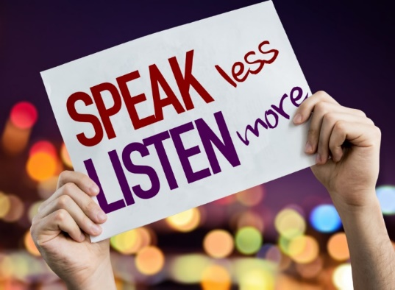
How to Validate
Give your full attention
Put away any distractions, make eye contact and if possible, move to a quiet place to have the discussion.
Let them talk
Sometimes, when having emotional conversations, we’re quick to jump in with our comments, unsolicited advice or reactions. Active listening shows respect and gives you the chance to completely understand the situation

Slide 40
How to Validate
Ask questions… to try to prompt the other person to:
Name how they’re feeling (naming emotions is central to acknowledging the feeling)
Identify what caused those emotions
From here, the discussion can adopt a more actionable direction
(if appropriate). Try asking questions such as:
“I want to totally understand this—can you explain to me how that made you feel?”
“What part of this situation made you feel most frustrated?”
“That would have upset me. Do you feel upset at this situation?”
“At what point of the situation did you start to feel like this?”

Slide 41
How to Validate
Acknowledging, reflecting, and accepting
Once you’ve both identified how the person is feeling, you can help cultivate a space in which that person feels safe to reflect on these emotions. To express empathy and understanding, you can incorporate validating statements like:
“I can understand why you feel that way”
“I can tell this is really important to you”
“What a frustrating/upsetting situation”
“I want to make sure I’m understanding correctly. What I’m hearing is…”
“I can see your efforts here”
“I appreciate your honesty here”
"What you're saying makes sense"
"That must have been a horrible feeling"

Slide 42
The Importance of Empathy
Empathy | Putting yourself in someone else’s shoes and experiencing the same feelings as that person. When we are empathic toward others, we try to see things from their perspective.
Helpful things to say:
I’m so glad you told me.
Tell me more, I’m here for you.
Try to see the world as others see it
Be non-judgmental
Validate another’s feelings
Communicate understanding

Slide 43

Proactive approaches to de-escalation
Reflect while watching
Why did this student act out?
Did you observe any approaches with the student that appeared to be helpful?
What could have perhaps been done differently to minimize an escalated situation?
https://youtu.be/X9_WwuGF4dM_
Notes:
8:23 Say: Let’s watch the following video on de-escalation.
Ask: Were any of the approaches to student behavior management and de-escalation we covered already today present in this video?
What could have been done differently to prevent the escalated situation?
Note: Video is 8 minutes and 23 seconds long.
Video url: https://www.youtube.com/watch?v=X9_WwuGF4dM&feature=emb_title

Slide 44
Video Debrief
Keep alert attention and with a calm presence
Keep focused on what you want to happen, not what is happening
Have team available (silent but available)
Use empathic listening
Keep verbal output to a minimum
Do not get involved in reasoning conversations with escalated students
  This is not the “teaching moment” time
Have a calming phrase
  “I will keep you safe.” or “When you are ready, we can…”
Have a process for tension reduction (recovery) for staff and student
44
Notes:
Restorative Practices Here
Adjust response to Bx or discipline

Slide 45
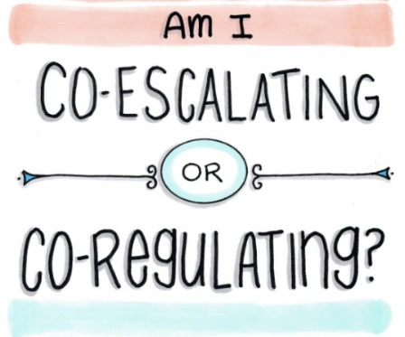
CONFLICT DE-ESCALATION STRATEGIES
Remain calm by using a low, “Green” tone of voice and not speaking over/arguing
Respect personal space – don’t get too close or try to grab something from the person
Ask the person to share the facts and what they are feeling by using open-ended questions. Say, “How can I help you?” or “Tell me what happened” instead of
“Why are you so angry?”
Empathize with the other person’s feelings (not necessarily the behavior). Say, “You have every right to feel frustrated about that.” Avoid addressing the behavior or yelling.

Slide 46
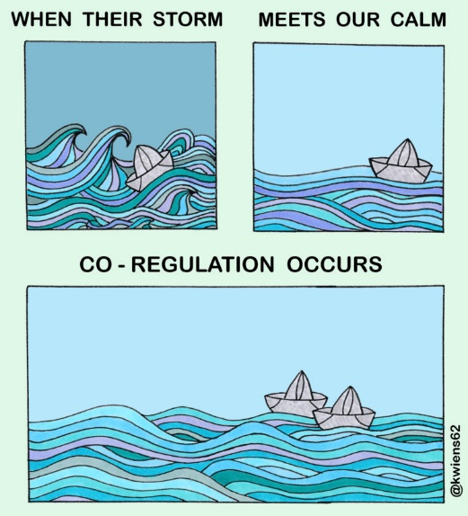
CONFLICT DE-ESCALATION STRATEGIES
Give the person choices instead of telling them what to do. Instead of forcing an agitated person right into a discussion, try offering a temporary break “Why don’t we take a minute before we continue this conversation?”
Restate/clarify what the person says. Show real interest in what the person has to say.
Give the person your full attention, including body language.
Remember that silence in the conversation is okay – it allows the individual time to figure out responses and to plan how to say what they need to say.
Thank the person for their positivity after the conflict is over

Slide 47

Relationship Between Stress/Anxiety & Sense of Control
There is often a direct correlation between the amount of
Stress and/or Anxiety we feel
we feel and the amount of
Control
that we perceive we have

Slide 48

Just Breathe
https://youtu.be/RVA2N6tX2cg?si=julyen-tniKdSu3x
48
Notes:
Direct: Find an elbow partner.
Say: To begin, think of some challenging student behaviors you have experienced in your role as a paraeducator.
Identify what made the behaviors challenging?
Why do you think the student displayed the behaviors?
What were some of the strategies that you used that were effective or ineffective in managing these behaviors?

Slide 49
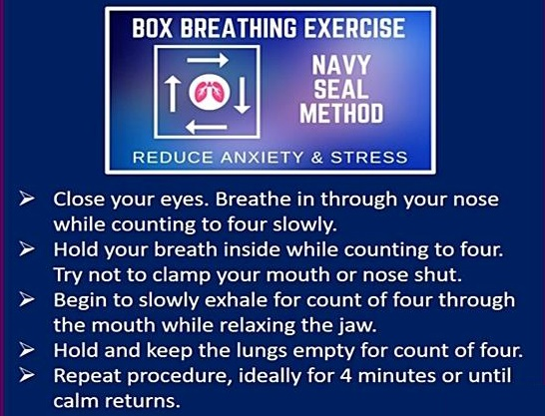

The Benefits of Breathing Techniques & Awareness
Anxiety due to fear of the unknown
Dwelling on memories of negative experiences
49
Notes:
Direct: Find an elbow partner.
Say: To begin, think of some challenging student behaviors you have experienced in your role as a paraeducator.
Identify what made the behaviors challenging?
Why do you think the student displayed the behaviors?
What were some of the strategies that you used that were effective or ineffective in managing these behaviors?

Slide 50
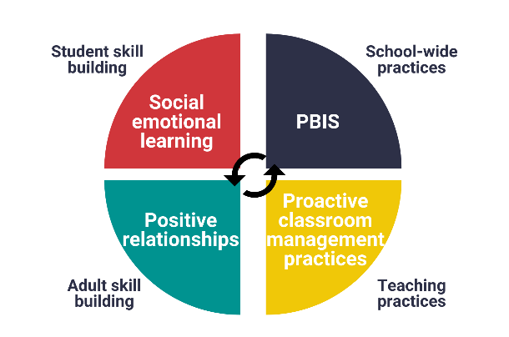
Bias: Awareness, Acknowledgment, Understanding
Research clearly shows that whether a teacher “believes in” their student affects how well that student does in school, regardless of the student’s abilities. Educators should be aware that teachers’ expectations can be influenced by their own implicit biases. Implicit biases are defined as attitudes or stereotypes that are activated unconsciously and involuntarily
(see the definition for implicit bias in the glossary of the WA SEL Implementation Guide).
Notes:
This statement from OSPI underscores that what we believe about students can impact how well they do in school.
(Pause on Punitive discipline) Punitive discipline may reflect a professionals beliefs about what students need to improve behavior.
What have you noticed are some biases that impact student learning?

Slide 51
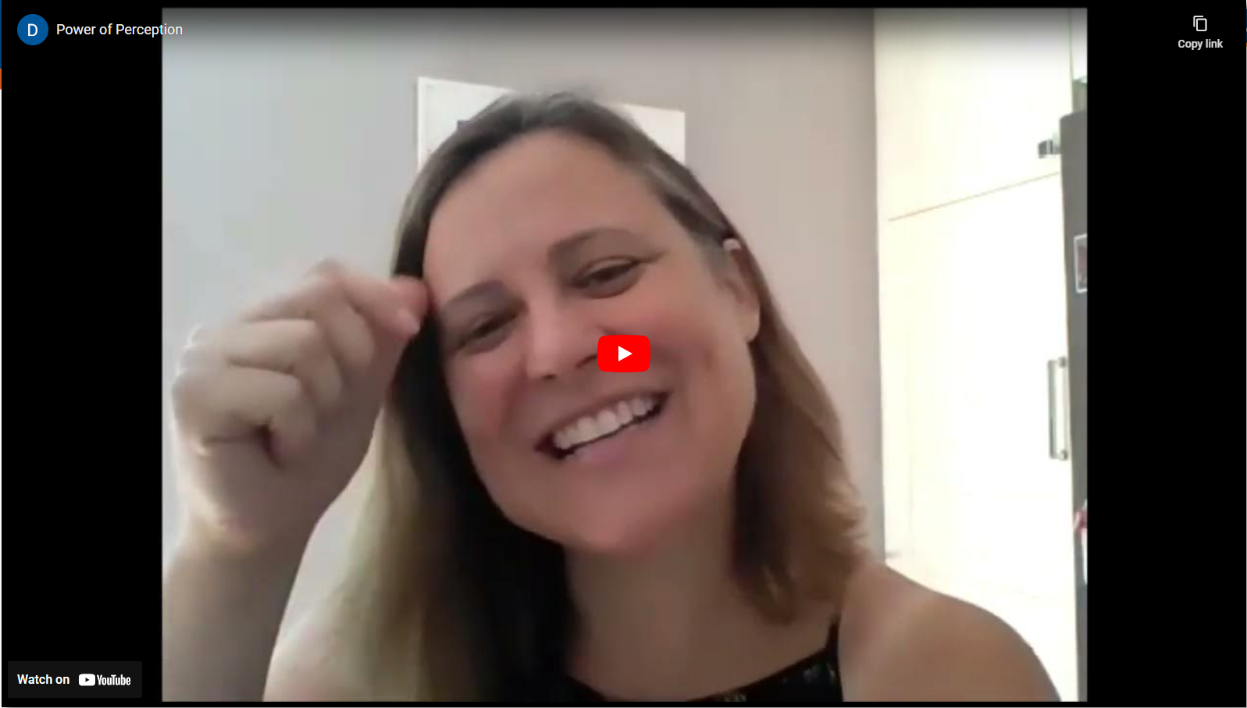
Bias: Awareness, Acknowledgment, Understanding
https://youtu.be/sHMJXcUJdNw
51
Notes:
5:30

Slide 52
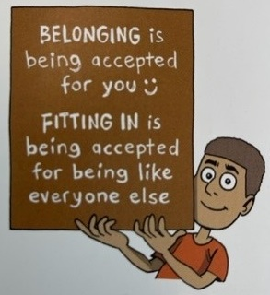
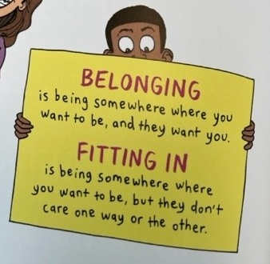

“Fitting In” vs “Belonging”
-Brené Brown
Atlas of the Heart
Fitting in is being accepted on their terms.
Belonging is where you can contribute and are valued.

Slide 53


The Power of Connection
https://youtu.be/7s22HX18wDY
Notes:
3:00

Slide 54

Moments That Affect A Life’s Trajectory

Slide 55


Critical Threshold of Change
When you add energy to increase the temperature from 26° to 27° you won’t see any apparent change in the ice. 28°, 29°, 30°, 31°. It doesn’t look like the energy you put in is making any difference. You may feel like quitting, but you keep going. And THEN…after 32°…the ice begins to melt!
Breakthrough moments are often the result of many previous actions, which build up the potential required to unleash a major change...
And this includes trust within relationships!

Slide 56
Final reflection
What new ideas about student behavior have you learned about today?
What will you do differently move forward?
What additional questions about student behavior or student behavior do you have?
How can you take this back to your team?
What do you need from your teacher, school to support your efforts?
Notes:
Say: As we think about all the strategies presented in this unit:
What new ideas for managing and responding to student behavior have you encountered?
What will you do differently moving forward?
What questions do you still have about anything in this unit?

Slide 57
What you learned today:
Identify specific roles in support of classroom management and student discipline(PBIS).
Define the philosophy of an inclusive and equitable learning environment.
Identify equitable and inclusive strategies that can be used to support a positive and safe learning environment including de-escalation strategies.
Identify positive and proactive supports that can be used within the classroom or school environment.
Define proactive approaches to student behavior management and de-escalation strategies.

Slide 58


